Slide 1
Online_job_portal system
Team:
Shashank D Jois (1NT18IS144)
Keerthan S (1NT18IS128)
Navachethan M (1NT18IS099)
Faculty:
Disha ma’am

Slide 2
Introduction:
Online job portal system is a database project.
The project is all about usage of MySQL with the concept of connecting the candidate with the recruiters for easy and smooth recruiting procedure.
Frontend is developed by using HTML5 and CSS3 and php is used as connectivity to connect the frontend with backend database.

Slide 3
About Synopsis:
Previously a synopsis was submitted that included the brief theory about our project.
It included the problem statement, Problem definition, Requirement specification, etc..

Slide 4
Project Description:
We have tried to build a database with quiet effective frontend and majorly focused on connecting the database with frontend.
Along with that we have worked on Adding the data though insert operation and displaying the data on the web using the select operation.
We have also tried to select the specific row of the database tables using select operation

Slide 5
PROBLEM DEFINITION:
The motivation of the project is the current COVID-19 situation across the globe that made it difficult for fresher's to get a job. Even employees are being fired in companies and they are finding it difficult to get a new job. Keeping these set of people in mind we opted the title-"ONLINE_JOB-PORTAL_SYSTEM".
The main theme or ideology behind the project is to use the database concepts and develop a platform that helps candidates to apply for their dream jobs through online and get an online interview appointed. Here the companies can upload the requirement specifications and select candidates based on the requirements.

Slide 6
Tools and technologies used:
HTML, CSS
PHP
MySQL
Wampp
PhpMyAdmin

Slide 7
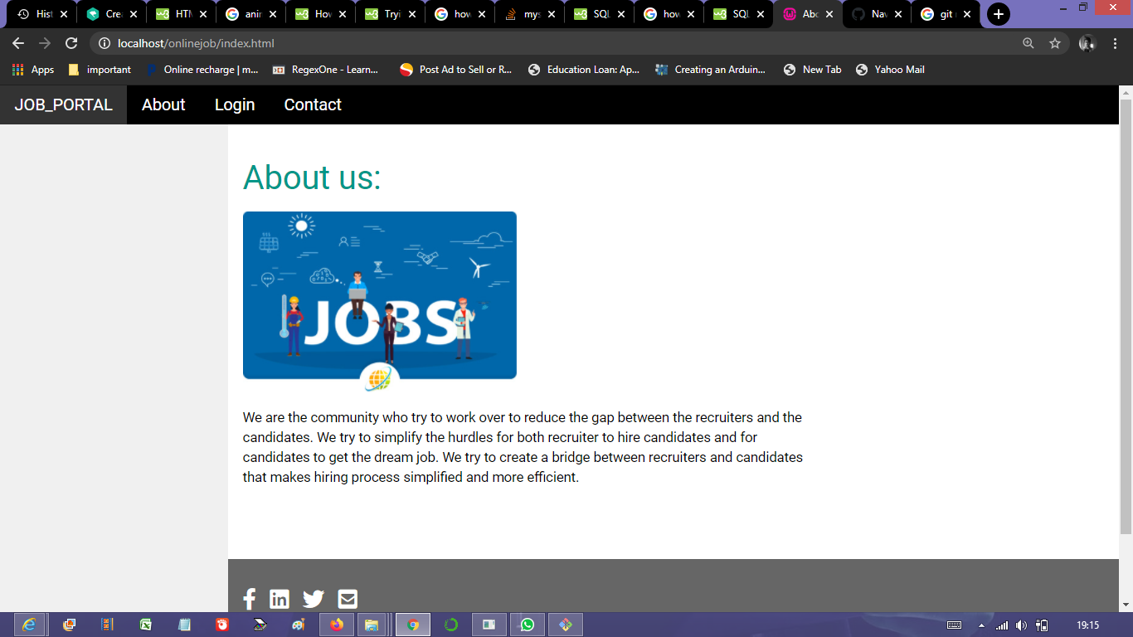
Images of our project:

Slide 8
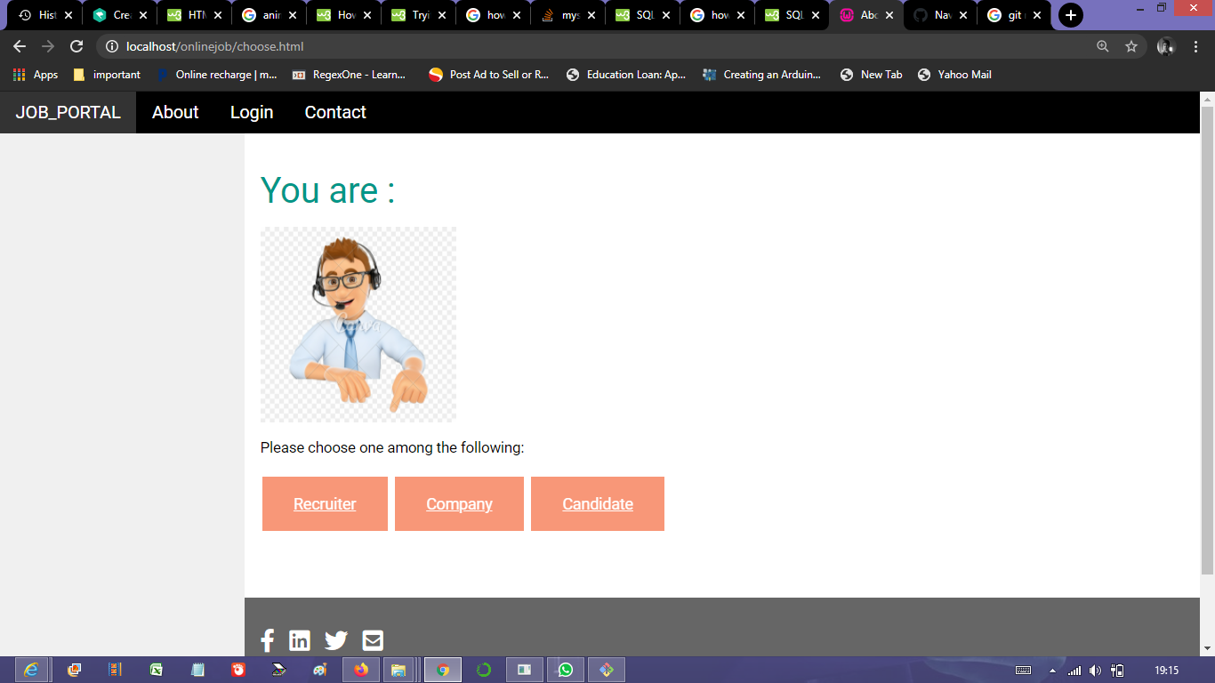
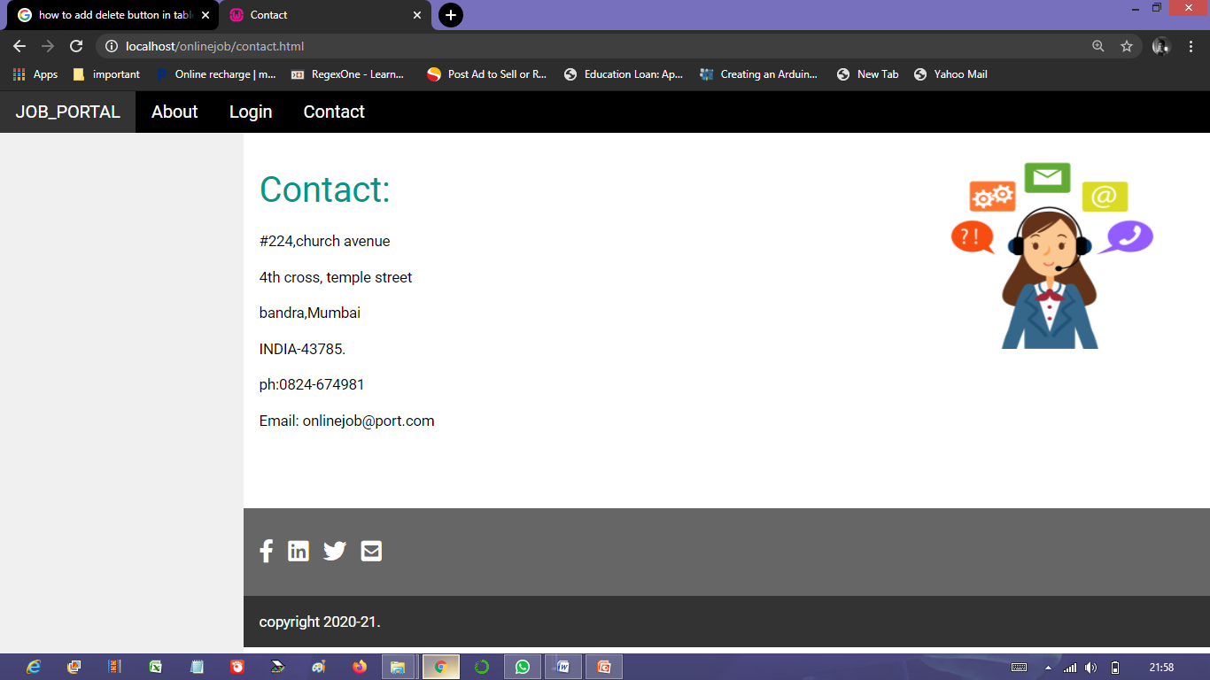

Slide 9
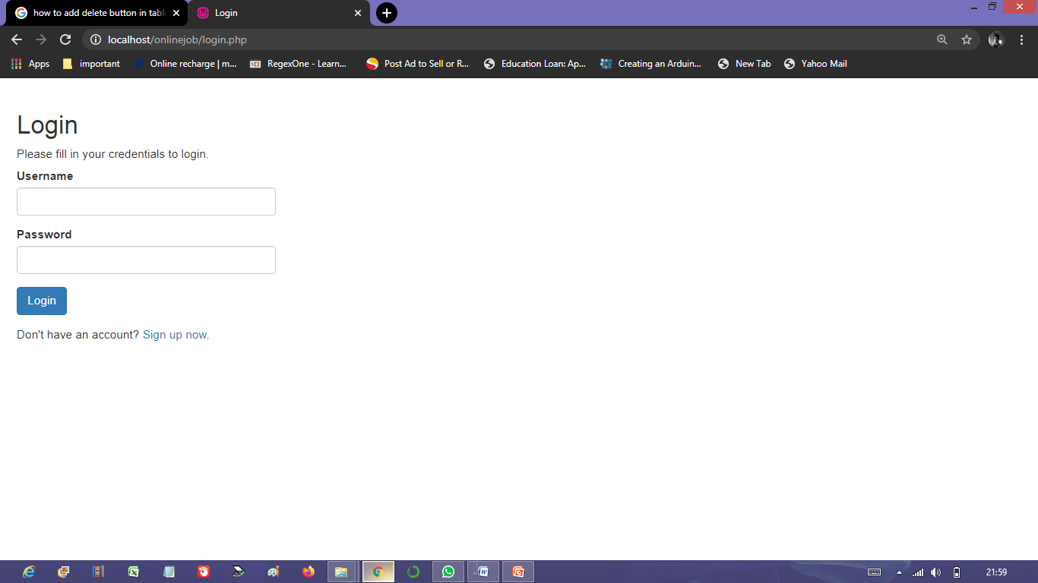
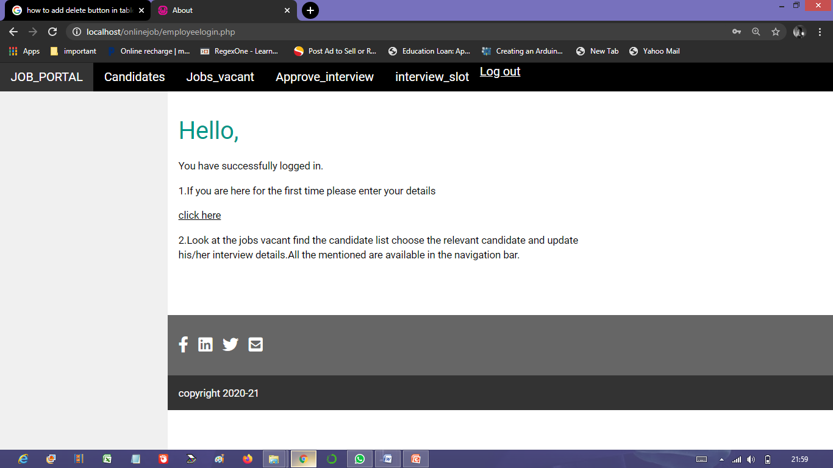

Slide 10
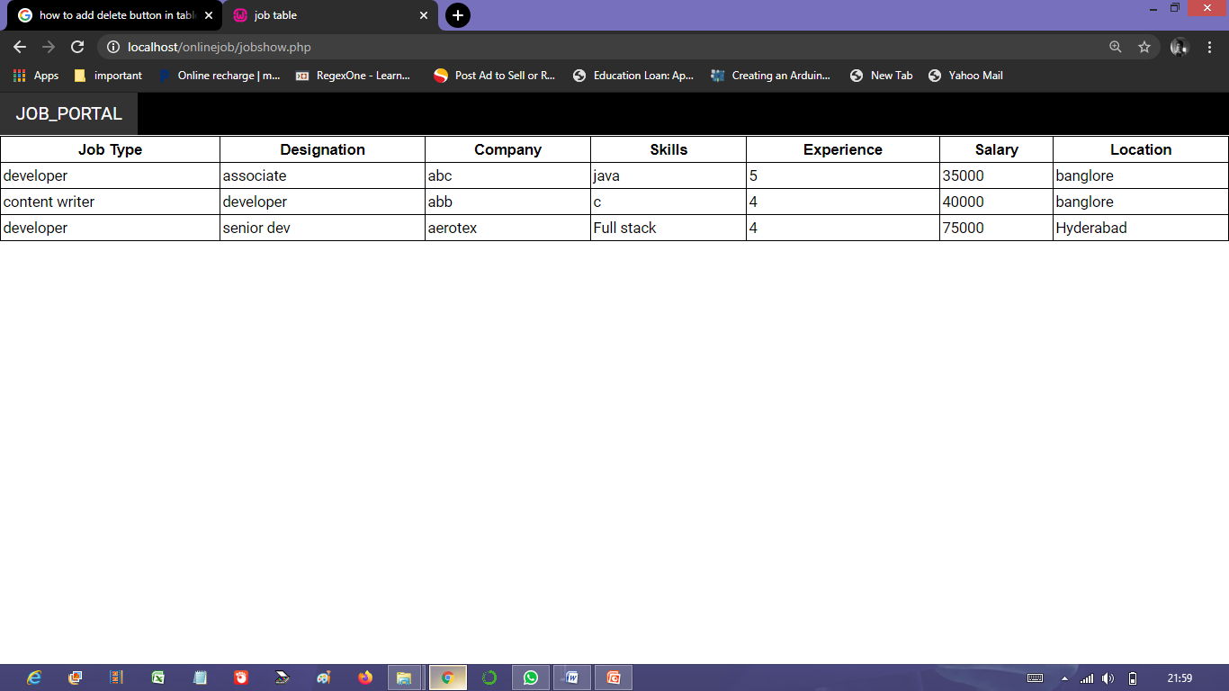
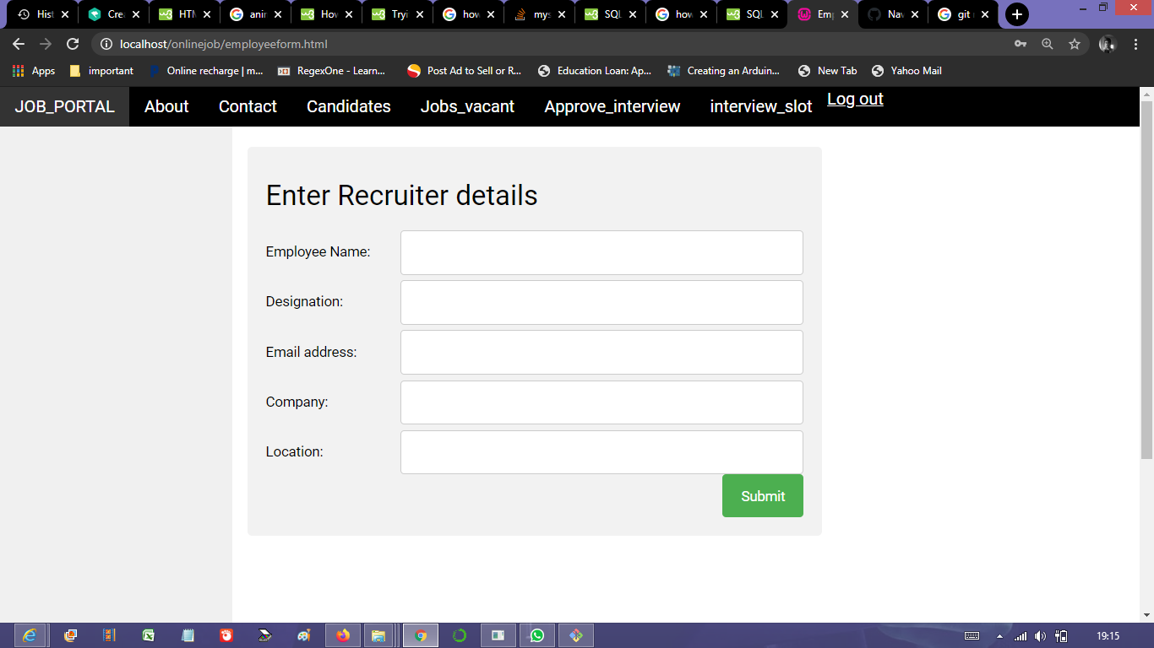

Slide 11
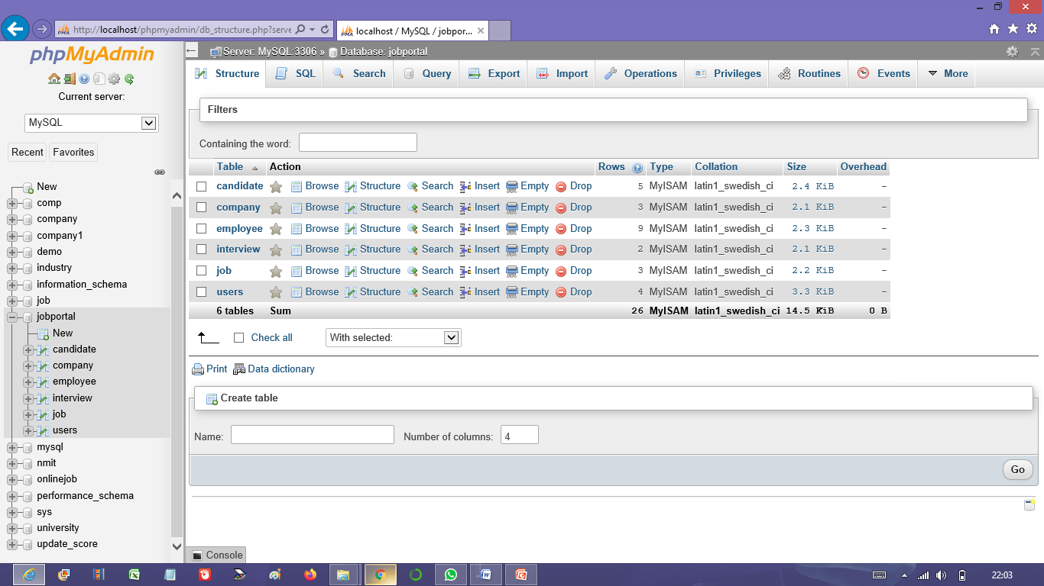
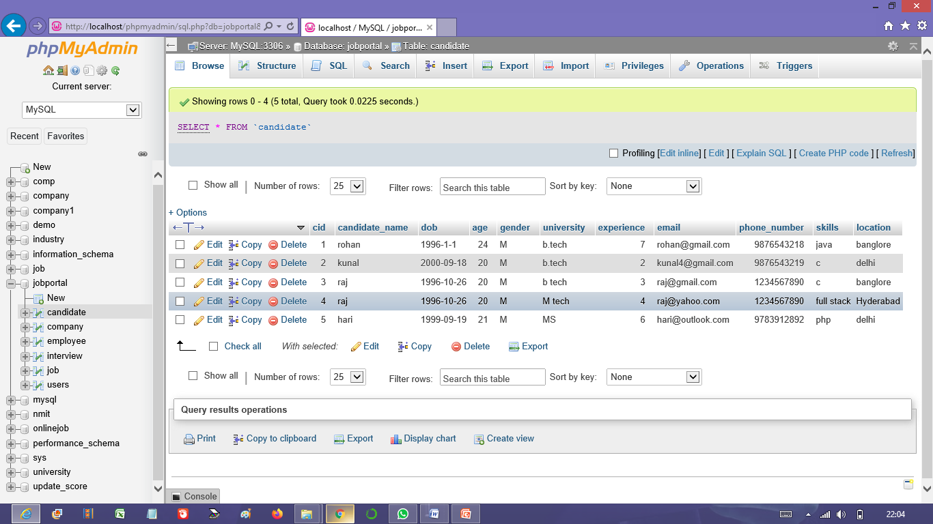

Slide 12
Conclusion:
The aim of the project was met.
We have successfully created the frontend webpage, database using RDBMS (MySQL) and used the concept of primary key.
We have integrated the frontend with the database using php.
Our project was working the way we assumed it to be.

Slide 13
Work distribution:
Keerthan: Frontend web development, php, used PhpMyAdmin.
Shashank: Frontend web development, MySQL database creation using wampp
Navachethan: php, MySQL database creation, Used PhpMyAdmin and github.

Slide 14


